Slide 1
Understanding and Predicting Flight Delay for Atlanta Airport
Nidhi Mariam Jolly & Tressy Thomas
Group Project MGSC5126, 2020 Fall
Cape Breton University

Slide 2
Outline
Overview and Objective
Related Works
Data and Methodology
Results
Conclusion

Slide 3
Flight delay problem
Overview
Causes inconvenience to customers, disrupt plans and sometimes disturb operations of supporting businesses and vendors
Providing faster, cheaper and reliable services are crucial factors that affect the efficiency of airline operations and customer satisfaction
Flight departure and arrival delays are significant factors that impacts the reputation and operation of airline services

Slide 4
Atlanta Airport
Overview
Hartsfield-Jackson International airport is a global gateway, offering non-stop service to more than 150 domestic and 70 international destinations ^{[1]}
One of the busiest and most efficient airports in the world.
15 airline operators

Slide 5
Objective
Leverage the data mining techniques to
Understand
Contribution of temporal factors such as time of the day, day of the week and week of the month towards flight delays.
Analyze
the severely affected airlines and routes originating or departing from Atlanta International airport.
Predict
For the future, if a flight would be delayed or not.

Slide 6
Previous Studies on flight delay prediction
Noriko Etani developed a predictive model with Random Forest Classifier with weather data performed the best with 77% accuracy ^{[3]}
Navoneel Chakrabarty proposed a model using ’Randomized Synthetic Minority Oversampling Technique’(SMOTE) to handle class imbalance and yielded 85.73% flight delay prediction accuracy ^{[5]}
Boija Ye et al recommends LightGBM model that provided the best result, giving 86.55 % accuracy ^{[6]}

Slide 7
Data and Methodology
Data and models for predicting flight delays

Slide 8
Data
Source: Bureau of Transportation Statistics
Domestic flights departed from and arrived at ATL airport during January 2019 to December 2019
Original dataset has 12 attributes and 783432 instances
Imbalanced data – 82% not delayed flights and only 18% delayed
Target variable is derived to indicate if there is delay or not
0 indicates no delay and 1 indicates delay

Slide 9
Data preprocessing
No Missing Values or outliers
Derived the target variable
Dropped the attributes used for target variable derivation
Dropped the irrelevant attribute ‘Year’
Prepared dataset has 783432 instances and 9 attributes.
Class label is binary to indicate the occurrence delay

Slide 10
Experimentation Set-up
Processor: Intel®Core™ i5 7200U CPU@2.50GHz
Platform: Windows 64-bit OS
R using IDE RStudio

Slide 11
Methods
Classification Models
Logistic Regression
Exploratory data Analysis
Data Aggregation
Data Visualization
k-NN Classifier
Extreme Gradient Boosting Machine

Slide 12
Exploratory Data Analysis
June
Reported highest delay at 28 % during 2019
Saturday
Less flights and less delays
Frontier Airlines
Highest delay. 32 % of flights are delayed
5 AM - 8 AM
Time frame of most number of schedules and delays

Slide 13
Top 10 Busiest Routes
Rank | Out of ATLANTA | Towards ATLANTA
1 | ATLANTA − > NEW YORK | NEW YORK− >ATLANTA
2 | ATLANTA − > ORLANDO | ORLANDO− > ATLANTA
3 | ATLANTA − > FORT LAUDERDALE | FORT LAUDERDALE− > ATLANTA
4 | ATLANTA − > CHICAGO | CHICAGO− > ATLANTA
5 | ATLANTA − > TAMPA | TAMPA− > ATLANTA
6 | ATLANTA − > WASHINGTON DC | WASHINGTON DC− > ATLANTA
7 | ATLANTA − > MIAMI | MIAMI− > ATLANTA
8 | ATLANTA − > BALTIMORE | DALLAS− > ATLANTA
9 | ATLANTA − > DALLAS | BALTIMORE− > ATLANTA
10 | ATLANTA − > NEWARK | NEWARK− > ATLANTA
Table 1. Top ten busiest routes in and out of Atlanta

Slide 14
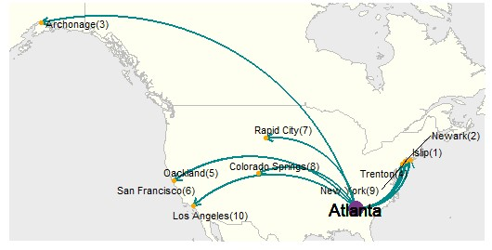
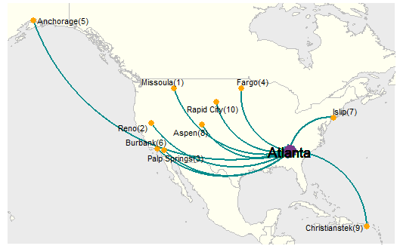
Top 10 Delayed Routes
Atlanta departures
Atlanta arrivals
Fig 1. Top ten delayed routes originating from Atlanta
Fig 2. Top ten delayed routes arriving at Atlanta
38.80% of flights departing from ATL airport to Islip airport are being delayed, which is the highest rate
About 61.50% of total flights operating from Missoula airport and Reno airport are being delayed when arrived at ATL airport

Slide 15
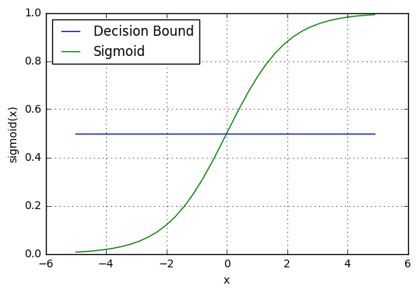


Data Model 1: Logistic Regression
Core of a logistic regression model is the odds ratio = P(1)/1-P(1)
The non-linear relationship between the inputs and the odds ratio can be flattened out to a linear relationship by computing the log of the odds ratio^{[7]}
p < 0.5 → No delay
p >=0.5 → Delay
Fig 3. Logistic Curve and decision boundary^{[7]}

Slide 16
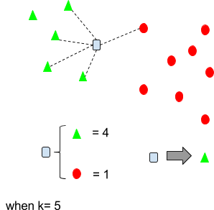
Data Model 2: k-Nearest Neighbor Classification
Algorithm
For each test tuple
Compute the distance between test tuple and the training tuples(We used Euclidean distance)
Find the k-nearest neighbors with respect to the distance.(we used k=5)
Use mode of k-nearest neighbors’ model to estimate the class of test tuple
Fig 4. k Nearest Neighbour Classifier Illustration^{[8]}

Slide 17
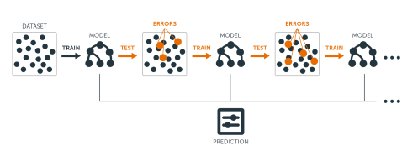
Data Model 3: Extreme Gradient Boosting Machine
Boosted trees are grown sequentially; each tree is grown using information from previously grown trees.
Algorithm
Fit a decision tree to the data: F1(x)=y
Then fit the next decision tree to the residuals of the previous: h1(x)=y−F1(x)
Add this new tree to our algorithm: F2(x)=F1(x)+h1(x)
Fit the next decision tree to the residuals of F2: h2(x)=y−F2(x),
Add this new tree to our algorithm: F3(x)=F2(x)+h1(x)
Continue this process until stop mechanism
Fig 5. Sequential Ensemble approach in Boosting^{[9]}
We have used number of tress=1000,
early stopping at 20

Slide 18
Results and Discussion
Data model performance

Slide 19
Classifier performance comparison
Used 70:30 split for training and testing
Classifier trained with under-sampled data
Classifier trained without under-sampled data
Evaluation Metric | Logistic Regression | kNN Classifier | XG Boost
Accuracy | 0.5818 | 0.584 | 0.692
Sensitivity | 0.5732 | 0.5793 | 0.699
Specificity | 0.6192 | 0.6047 | 0.6612
Balanced Accuracy | 0.5962 | 0.5920 | 0.6801
Evaluation Metric | Logistic Regression | kNN Classifier | XG Boost
Accuracy | 0.8139 | 0.7921 | 0.8345
Sensitivity | 1.0000 | 0.9361 | 0.9696
Specificity | 0.0000 | 0.1625 | 0.2439
Balanced Accuracy | 0.5000 | 0.5493 | 0.6067
Table 2. Classifier performance evaluation metrics with under-sampling technique
Table 3. Classifier performance evaluation metrics without under-sampling technique

Slide 20
Discussion
XGBoost with 1000 iterations was able to produce an accuracy of 83.45% and balanced accuracy of 60.67%
Logistic model is no better than random guess if used without imbalanced data treatment
Models with under-sampling gives better predictions considering all the evaluation metrics.
Temporal factors have more significance than location factors in predicting the delay using the data models

Slide 21
Conclusion
Successfully analyzed and understood the temporal and location factors influencing the flight delay at Atlanta airport
Able to predict the delay of airline operation with 83 percentage accuracy
Limitations
FUTURE SCOPE
Limited computing resources
Tuning of XGBoost hyper parameters
More advanced imbalanced data treatment methods

Slide 22
References
[1] Statistics — ATL — Hartsfield-Jackson Atlanta International Airport. (2018). http://www.atl.com/business-information/statistics/
[2] Assent I., Krieger R., Welter P., Herbers J., Seidl T. (2009) Data Mining For Robust Flight Scheduling. In: Cao L., Yu P.S., Zhang C., Zhang H. (eds) Data Mining for Business Applications. Springer, Boston, MA. https://doi.org/10.1007/978-0-387-79420-4 19
[3] Etani, N. Development of a predictive model for on-time arrival flight of airliner by discovering correlation between flight and weather data. J Big Data 6, 85 (2019). https://doi.org/10.1186/s40537-019-0251-y
[4] Aljubairy, A., Zhang, W.E., Shemshadi, A. et al. A system for effectively predicting flight delays based on IoT data. Computing 102, 2025–2048 (2020). https://doi.org/10.1007/s00607-020-00794-w
[5] N. Chakrabarty, “A data mining approach to flight arrival delay prediction for American airlines,” 2019. doi: 10.1109/IEMECONX.2019.8876970
[6] B. Ye, B. Liu, Y. Tian, and L. Wan, “A methodology for predicting aggregate flight departure delays in airports based on supervised learning,” Sustainability (Switzerland), vol. 12, no. 7, 2020, doi: 10.3390/su12072749.
[7] Website: https://ml-cheatsheet.readthedocs.io/en/latest/logistic_regression.html#sigmoid-activation
[8] Website: https://tyronmadushanka.blogspot.com/2017/02/hands-on-k-nearest-neighbour-algorithm.html
[9] Website: http://uc-r.github.io/gbm_regression#xgboost

Slide 23
Thank you!

Slide 24
Supplementary Materials
Rank | Route with Departure delay at ATL | % delayed | Route with Arrival delay at ATL | % delayed
1 | ATLANTA − > ISLIP | 38.8 | MISSOULA − > ATLANTA | 61.5
2 | ATLANTA − > NEWARK | 34.6 | RENO− > ATLANTA | 61.5
3 | ATLANTA − > ANCHORAGE | 33.9 | PALP SPRINGS− > ATLANTA | 54.6
4 | ATLANTA − > TRENTON | 33.4 | FARGO− > ATLANTA | 47.8
5 | ATLANTA − > OAKLAND | 32.8 | ANCHORAGE− > ATLANTA | 37.5
6 | ATLANTA − > SAN FRANCISCO | 31.9 | BURBANK− > ATLANTA | 35.8
7 | ATLANTA − > RAPID CITY | 30.8 | ISLIP− > ATLANTA | 32.3
8 | ATLANTA − > COLORADO SPRINGS | 29.0 | ASPEN− > ATLANTA | 32.3
9 | ATLANTA − > NEW YORK | 28.7 | CHRISTIANSTE− > ATLANTA | 31.5
10 | ATLANTA − > LOS ANGELES | 28.7 | RAPID CITY− > ATLANTA | 30.8

